Slide 1
Network configuration & network management tool
Bi-Weekly Reporting

Slide 2
Current progress
Pre-development testing
Netmiko SSH scripts
NAPALM
User Functionality, User story & User Flow
Started building the backend
Ubuntu server with:
GNS3 Remote Server
Django Web Server
Setup development environment
Pycharm – Currently running in a virtual environment

Slide 3

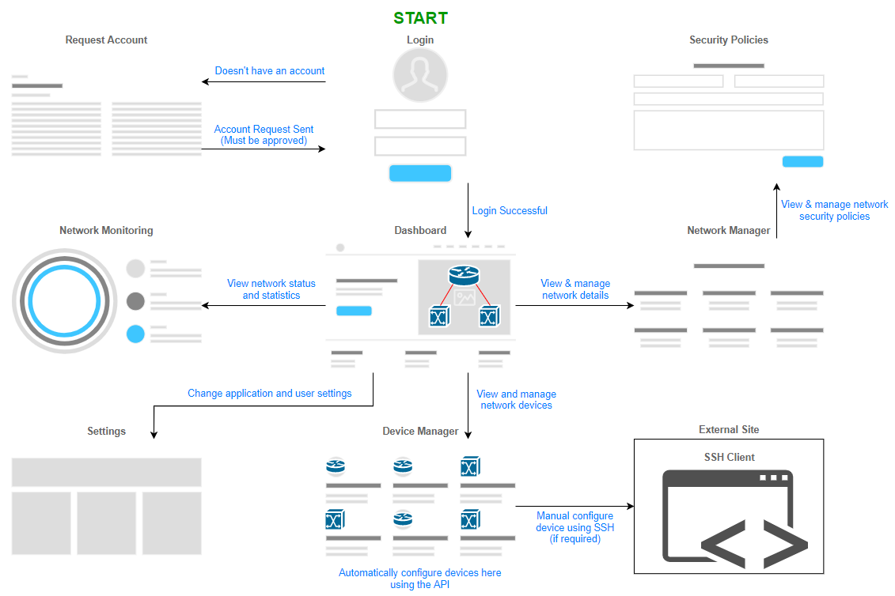
User Flow/Storyboard

Slide 4
Next sprint
Finish building the backend
Design & build webpages
Finish the python network scripts

